Slide 1
Specialization & Generalization & Aggregation
Arth Desai
Dapeng Jin
Jin Xu
Xuenan Wang
Wenhao Luo

Slide 2
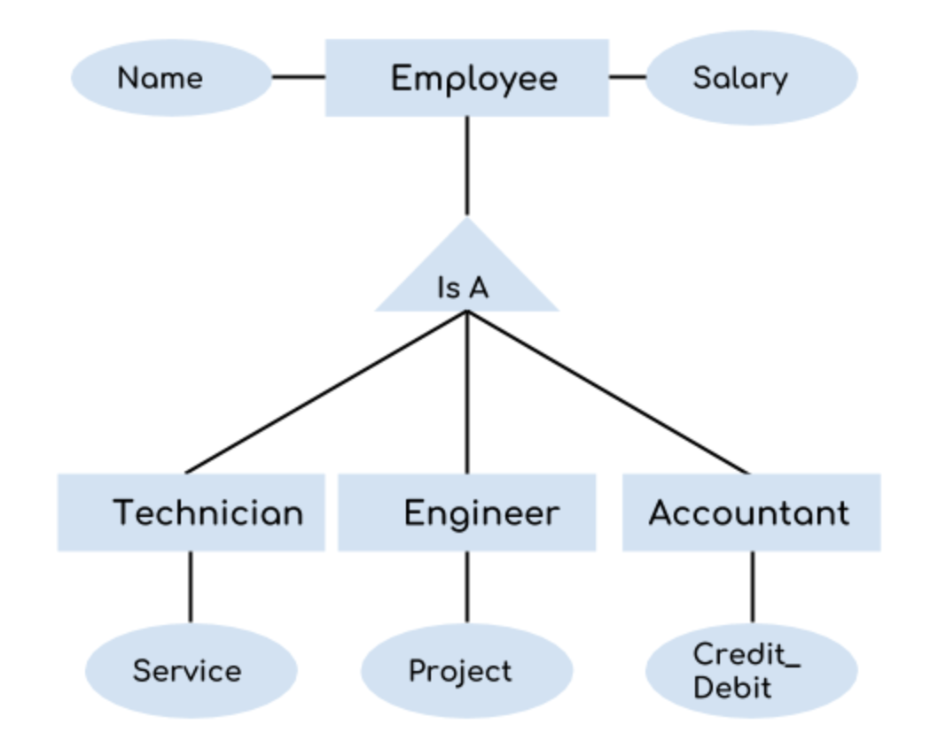
Specialization
Notes:
we can see that we have a higher level entity “Employee” which we have divided in sub entities “Technician”, “Engineer” & “Accountant”. All of these are just an employee of a company, however their role is completely different and they have few different attributes. Just for the example, I have shown that Technician handles service requests, Engineer works on a project and Accountant handles the credit & debit details. All of these three employee types have few attributes common such as name & salary which we had left associated with the parent entity “Employee” as shown in the above diagram.

Slide 3
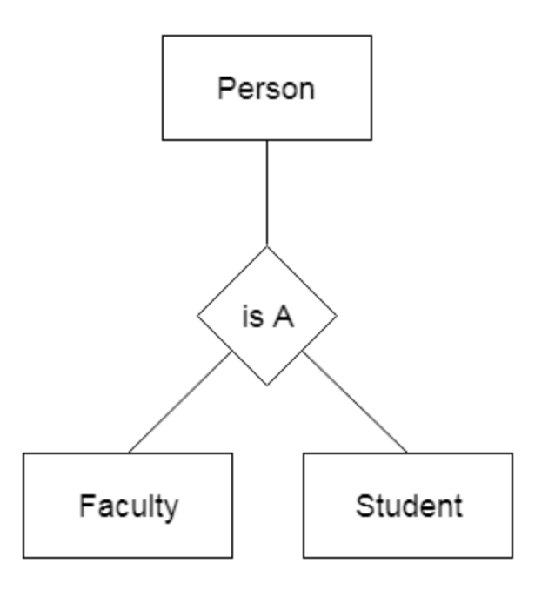
Generalization
Notes:
Faculty and Student entities can be generalized and create a higher level entity Person.

Slide 4
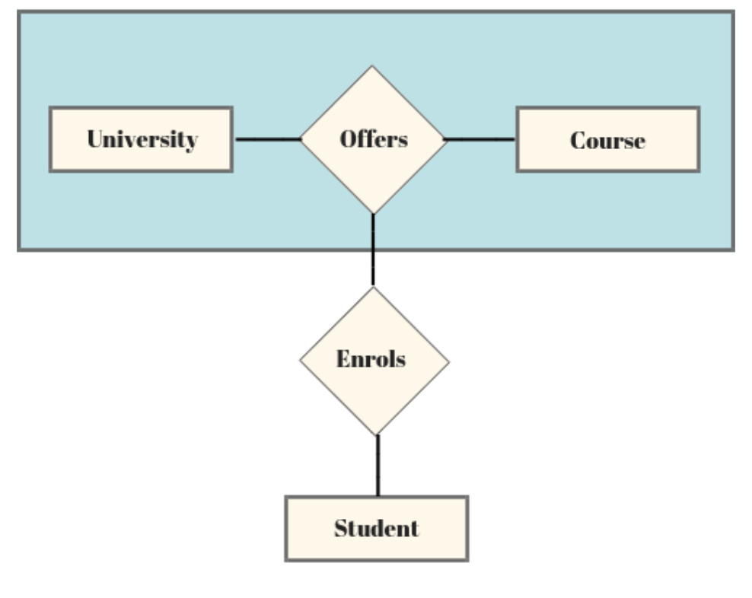
Aggregation
Notes:
University offering course can be considered a same entity, when viewed from a student entity perspective.

